Slide 1
Huawei OcenStor 100D: A Technology Deep Dive Boston Storage Solution Group May 2020
Notes:
Good morning, good evening and good afternoon everyone.
Welcome to Huawei OceanStor 100D Technology Deep Dive.
This is ……, which is also part of the Futurewei Boston Storage Center. It’s my honor to host today’s deep dive session. Before

Slide 2
Core Requirements for Distributed Storage Systems
Scalability
Distributed Storage Hot Issue Statistics ¹
60.7%
60.1%
58.2%
Usability
56.6%
Performance
51.5%
50.8%
Core Requirements
47.3%
36.4%
Reliability
High scalability
Reliability
I/O performance
Usability
Cost
Hotspot performance
Data security
Features
Cost
Scalability
Reliability
Performance
Usability
Cost
1 source: 130 questionnaires and 50 bidding documents from carriers, governments, finance sectors, and large enterprises

Slide 3
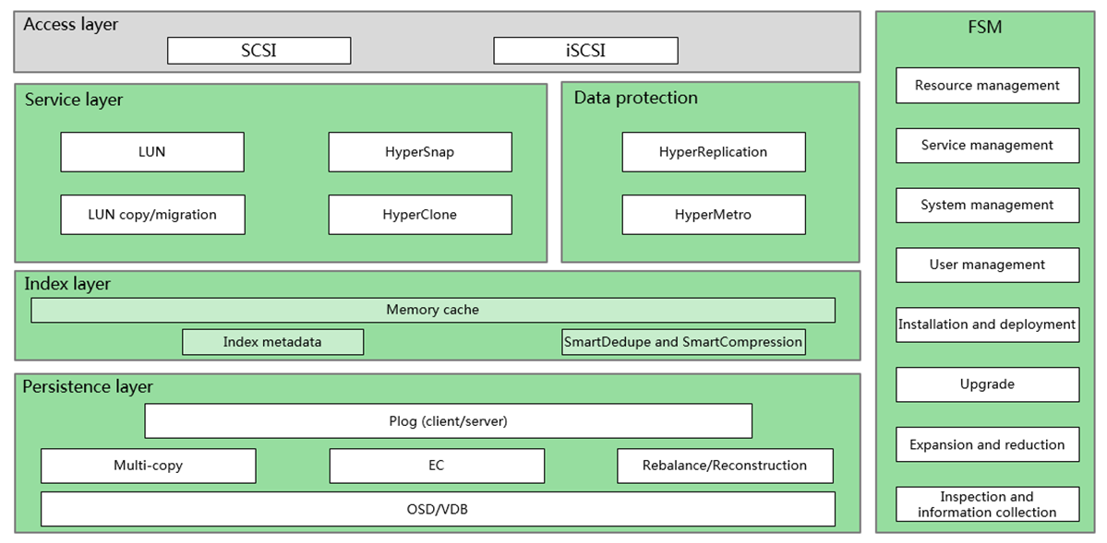
OceanStor 100D Block Software Architecture Diagram
Scalability
Reliability
Performance
Usability
Cost
Notes:
Software architecture complies with industry-leading scale-out, service-oriented, and microservice-based design principles.
s shown in the preceding figure, FusionStorage object storage consists of three layers: persistence layer, index layer, and service layer. These layers are described as follows:
● The persistence layer is composed of general-purpose servers and storage media. It is responsible for data layout, load balancing, and data recovery, and provides EC data redundancy, striking a balance between performance and costs. The persistence layer is the foundation of FusionStorage object storage and determines the system scalability, performance, and reliability.
● The index layer is responsible for metadata distribution, indexing, and failover in the event of faults. It provides high-speed metadata access and query capabilities for the service layer. As shown in the preceding figure, the metadata of the index layer is eventually stored in the persistence layer. Therefore, the metadata enjoys the data storage capability of the persistence layer and is evenly stored on nodes, ensuring system reliability.
● The service layer provides S3 APIs. It provides access to the object storage service, a global namespace, and a variety of value-added features, such as deduplication, QoS, multi-tenant, and quota. In addition, FusionStorage object storage supports mainstream object storage protocols and implements on-demand storage resource allocation.

Slide 4
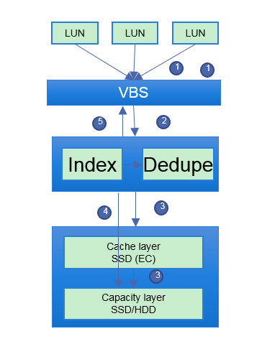
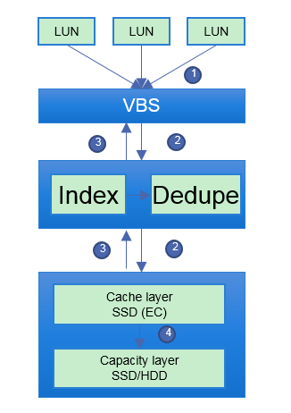
I/O Processing in 100D Block
Read I/O process
Write I/O process
VBS forwards write request to a specific node calculated using the DHT hash algorithm at layer 1.
After receiving the request, EDS writes the data to SSD cache disks and keep it in RAM. After that, EDS returns a write success message to VBS, and VBS forwards the message to the upper-layer application.
After the data in the memory is aggregated into a large block, the system flushes the data to storage media at the capacity layer.
Application sends a read I/O request to VBS, it then forward the request to a specific node calculated using the DHT hash algorithm at layer 1.
After receiving the request, EDS (Index+Dedupe) on the node searches for the required data in the following order: memory write cache -> memory read cache -> SSD cache -> storage media.
Scalability
Reliability
Performance
Usability
Cost
Notes:
Read cache: multi-tier smart read cache ensured best hit ratio. Explain hit ratio and how it impact I/O latency.
Write cache: SSD cache is written in EC mode to ensure data safety, and endures power loss. Write aggregation improves write performance and reduce disk wear, making it friendly to append-only algorithm and very SSD friendly.

Slide 5
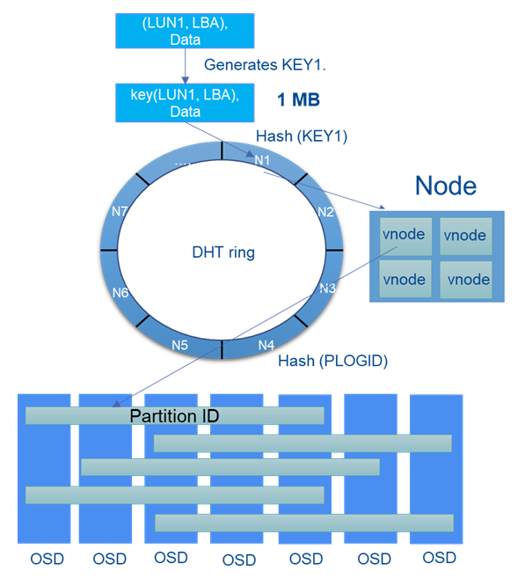
OceanStor 100D DHT Algorithm
The STORE DHT routing algorithm used in OceanStor 100D has the following characteristics:
Balance: Data is distributed to all nodes as evenly as possible, thereby balancing loads among nodes.
Monotonicity: When new nodes are added to the system, the system redistributes data among nodes. Data migration is implemented only on the new nodes, and the data on the existing nodes is not significantly adjusted – expansion is very smooth.
Each storage pool has a shard DHT ring. Each shard DHT ring has 4096 shards, and the 4096 shards are evenly allocated to the nodes in a storage pool. Suppose that a storage pool has 16 nodes. The 4096 shards will be evenly allocated to the 16 nodes. Each node processes 256 shards (that is, 4096/16).
Each LUN in the storage system is divided into multiple shards at the granularity of 1MB. Key of each shard is calculated based on hash of the LUN ID and start LBA.
Scalability
Reliability
Performance
Usability
Cost
Notes:
By using a one-time addressing DHT routing algorithm, the access service of FusionStorage storage is loosely coupled with the storage service and nodes are stateless. Based on load balancing, any node can process service requests. The number of nodes is not limited by status synchronization or locking mechanisms, and theoretically can be infinitely increased to support linear capacity expansion.
The DHT ring of FusionStorage object storage contains a maximum of 232 logical space units, and is evenly divided into N partitions. The N partitions are evenly allocated on all disks in the system. For example, if N is 3600 and the system has 36 disks, each disk is allocated 100 partitions. The system configures the partition-disk mapping during system initialization and will adjust the mapping accordingly after the number of disks in the system changes. Mapping tables occupy only a small space and are stored in the memory of the primary management node for fast routing.
Shard DHT routing is implemented as follows:
Suppose that an upper-layer application delivers a request to write data whose LUN ID is 1, start LBA is 64 MB, and length is 2 MB. The system first divides the data into two shards: S2 (64 MB to 65 MB) and S3 (65 MB to 66 MB). By using the shard DHT routing algorithm, the system forwards S2 and S3 to Node1 and Node2 respectively for processing.
FusionStorage存储采用分布式集群管理方式，从架构上保证了系统不会出现单点故障，一个节点或者一块硬盘故障自动从集群内隔离出来，不影响整个系统业务的使用。具体为：
Zookeeper：Zookeeper也称作ZK。为MDC提供选主仲裁。ZK还存储系统初始化时产生的元数据，包括“分区-硬盘”映射关系等数据路由信息。一个系统部署奇数个Zookeeper组成集群，最少部署3个，必须保证大于总数一半的Zookeeper处于活跃可访问状态。一旦系统部署不能再扩容ZK数量。
MDC：元数据控制软件，实现对分布式集群的状态控制。系统初始至少部署3个MDC模块，增加资源池自动为该资源池启动或指定一个MDC。多个MDC利用Zookeeper选举一个主MDC，主MDC监控其它MDC，发现MDC故障则重启MDC或为资源池指定托管MDC。当主MDC故障时，通过选举产生新的主MDC。

Slide 6
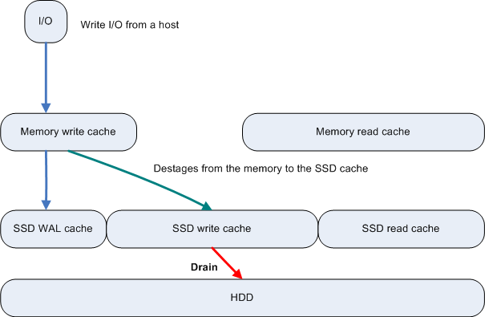
Write Cache
When VBS sends a write I/O , the write I/O is stored in the memory write cache. In addition, the write I/O is synchronously recorded into the SSD WAL cache in the form of logs using the 2+2 EC scheme and a write success message is returned. This process is called the host write I/O process.
As data in the memory write cache is gradually flushed to the SSD write cache, data in the SSD WAL cache will be eliminated. Asynchronous garbage collection is usually performed on such data.
When the data storage watermark in the SSD write cache reaches threshold , the data is migrated to HDDs from the SSD write cache.
Scalability
Reliability
Performance
Usability
Cost
Notes:
WAL = Write Ahead Log
Boundary of components: Memory write cache is in EDS, everything else is in OSD.

Slide 7
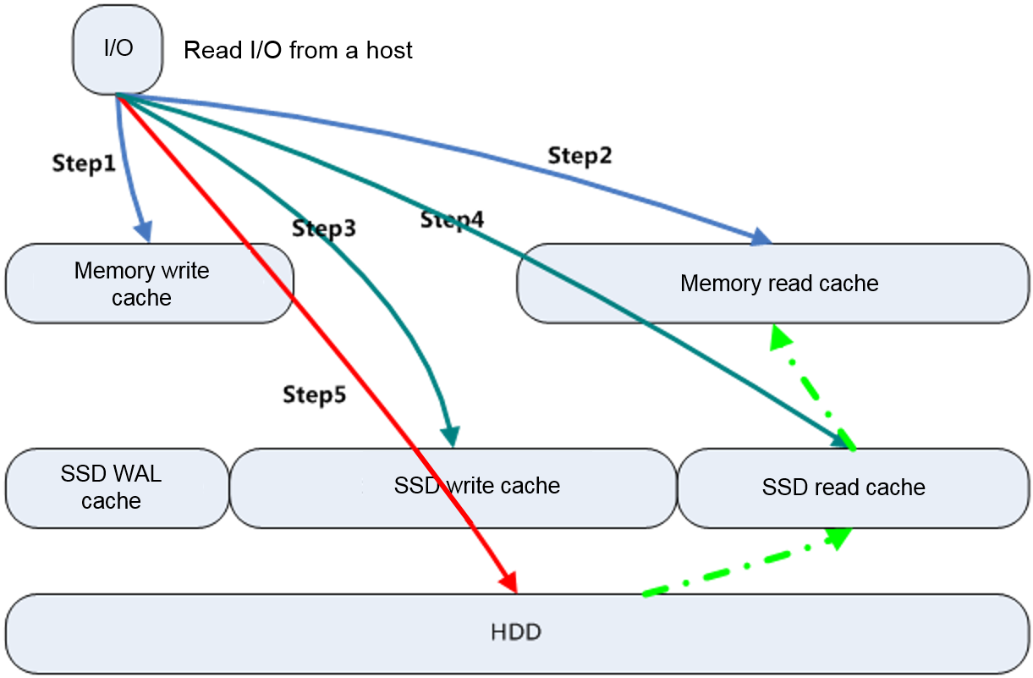
Read Cache
Step 1: The OSD checks whether required I/O data is in the memory write cache. If the data is in the memory write cache, the OSD returns the data and moves the data to the head of the LRU queue in the read cache. Otherwise, the OSD proceeds to Step 2.
Step 2: The OSD checks whether the required I/O data is in the memory read cache. If the data is in the memory read cache, the OSD returns the data and increases the hotspot access factor of the data. Otherwise, the OSD proceeds to Step 3.
Step 3: The OSD checks whether the required I/O data is in the SSD write cache. If the data is in the SSD write cache, the OSD returns the data. Otherwise, the OSD proceeds to Step 4.
Step 4: The OSD checks whether the required I/O data is in the SSD read cache. If the data is in the SSD read cache, the OSD returns the data and increases the hotspot access factor of the data. If the hotspot access factor reaches the threshold, the OSD fetches the data to the memory read cache. If the data is not in the SSD read cache, the OSD proceeds to Step 5.
Step 5: The OSD locates the required I/O data on disks and returns the data. In addition, the OSD increases the hotspot access factor of the data. The OSD fetches the data to the SSD read cache if the hotspot access factor reaches the threshold.
Scalability
Reliability
Performance
Usability
Cost

Slide 8
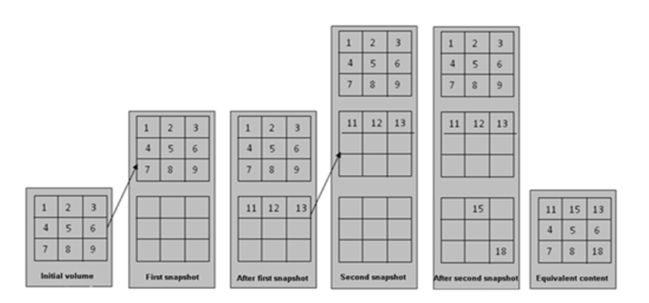
HyperSnap in 100D Block
Redirect-on-write (ROW)
Figure. HyperSnap of 100D [1]
In the Wikipedia page [2], ROW is defined as “the original storage is never modified. When a write request is made, it is redirected away from the original data into a new storage area.”
vs. Copy-on-write (COW)
COW is defined as “when a write request is made, the data are copied into a new storage area, and then the original data are modified.” The copy causes performance impact.
Initial volume
First Snapshot
After First Snapshot
Second Snapshot
After Second Snapshot
Equivalent content
Updates to LUN after snapshots will be redirect-on-write (ROW)
LUN logical view
100D uses the ROW mechanism to create snapshots, which imposes no adverse impact on volume performance.
[1] Figure 4-6, Page 36, Huawei FusionStorage 8.0 Technical White paper
[2] https://en.wikipedia.org/wiki/Copy-on-write, Wikipedia
Scalability
Reliability
Performance
Usability
Cost
Notes:
Feature & performance
ROW is more efficient, CEPH is still COW. Huawei is one of the 1st realizing this enterprise level feature in distributed storage

Slide 9
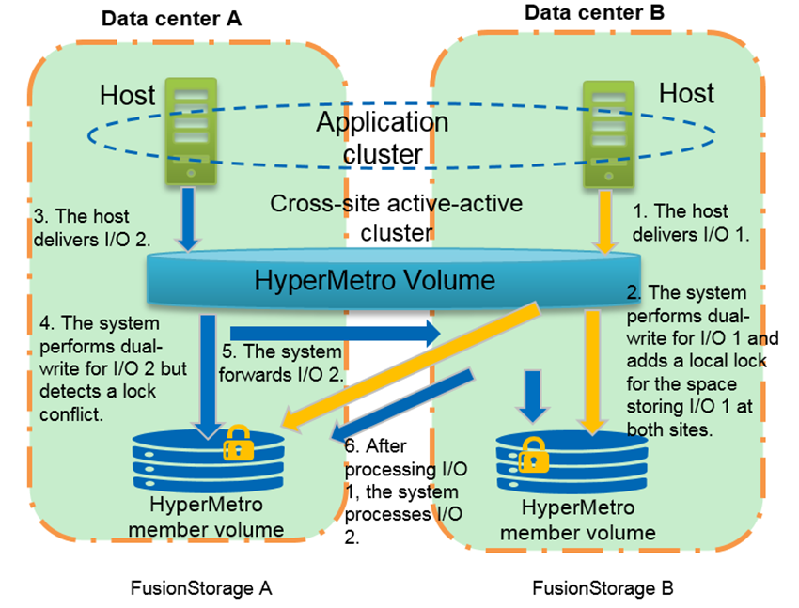
HyperMetro in 100D Block
The HyperMetro volume can accept writes in an active-active way from both sides. But the HyperMetro feature provides a consistency guarantee.
If write conflicts happen, the writes will be serialized on one side.
Figure. HyperMetro of 100D [1]
[1] Figure 4-10, Page 39, Huawei FusionStorage 8.0 Technical White paper
Scalability
Reliability
Performance
Usability
Cost
Notes:
1st to offer enterprise feature on distributed storage
vs CEPH
Optimistic locking (step 5) handles conflict

Slide 10
OceanStor 100D – Enterprise Class One Storage/One Data Center Solution
Fast
Reliability
Saving
2 Converged critical workloads
Traditional workloads
DB
Emerging workloads
Container, AI, & IoT
3 Converged clouds
Key point 1: Elastic EC
Key point 2: Global Adaptive Deduplication & Compression
Key point 3: FlashLink Acceleration
Key point 4: Across-AZ EC/HyperMetro
Key point 5: Free Data Flow Across Clouds
Public cloud
One DC,
One Storage
1 Converged protocols
File
DB
Block
HDFS
Object
Multi protocol
Edge cloud
4 Converged scenarios
2
Intelligent balancing/copy
Ever-new storage
Data Migration Free
Key point 6: Ever-New Storage, No Data Migration
ARM node
x86 node
Old node
1
New node
3
Old node exits
5 Converged management
DevOps
Production
Backup
DB
CDM
Data Intelligence
Key point 7: Intelligent Operations and Maintenance and Data Lifecycle Management
FusionDJ
Resource
Delivery
Data Flow
Fault
Analysis
Risk
Prediction
Replica
Management
Scalability
Reliability
Performance
Usability
Cost
Notes:
This page is to echoes the five convergence and three customer benefits realized by OceanStor 100D and to lead the seven supporting technologies of OceanStor 100D
There are 7 key technologies inside OceanStor 100D:
Elastic EC to provide high reliability with performance and minimize the cost
Global adaptive dedupe and compression.
FlashLink Algorithm acceleration
Across AZ EC and Hypermetro to provide 6 9s availability
Free Data flow across clouds and different tiers of storage to provide ultimate cost effective data management solution.
Ever new storage without data migration. A one click cluster expansion, storage rebalancing provides customer extra flexibility.
Intelligent O&M and data lifecycle management with DJ and CDM
Q: People generally believes that the thinner the stack, the better the performance, why Huawei storage has three service layers instead of the two layers from our competitors? Is there any impact to the performance? What are the primary benefits?

Slide 11
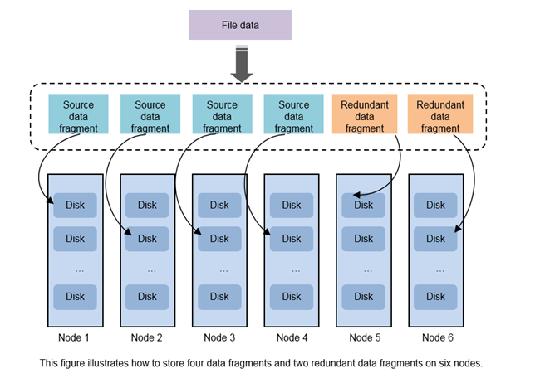
KP1: Elastic EC
Data written into 100D is divided into N data fragments, and M parity fragments are generated for the N data fragments using EC. If M fragments are damaged in an EC group, the system implements data recovery from the N fragments.
The EC data protection mode maintains high disk utilization of N/(N + M).
When nodes are faulty and the number of normal nodes does not meet the minimum quantity required by an EC scheme, users are allowed to reduce data fragments to ensure that the reliability does not deteriorate. The reduction rule is (N/2 + M). For example, EC scheme 4+2 is shrunk to 2+2, EC scheme 8+2 to 4+2.
Figure. EC of 100D [1]
[1] Figure 8-2, Page 61, Huawei FusionStorage 8.0 Technical White paper
Scalability
Reliability
Performance
Usability
Cost

Slide 12
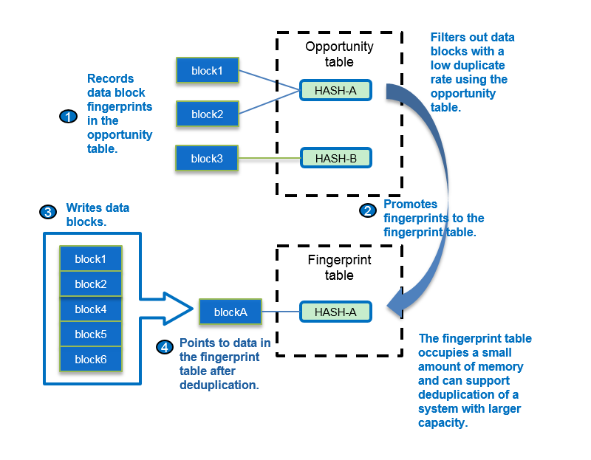
KP2: Smart Deduplication
Scalability
Reliability
Performance
Usability
Cost

Slide 13
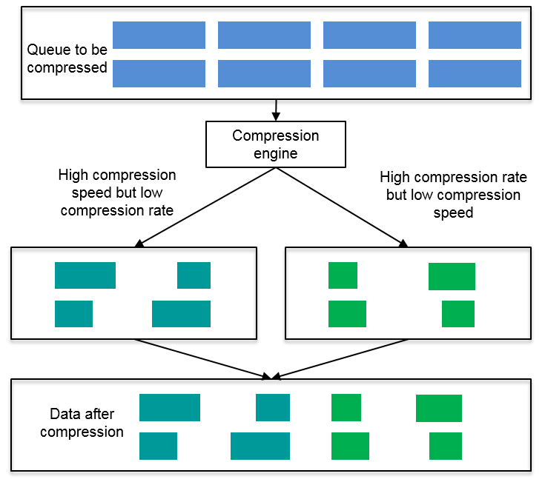
KP2: Smart Compression
The compression engine runs in a combination of two different compression algorithms. One is the algorithm with high compression speed but low compression rate and the other one is the algorithm with high compression rate but low compression speed.
By configuring different execution ratios of the two compression algorithms, users can obtain different performance and data reduction rates.
Only one compression algorithm can be selected for a storage pool. Changing the compression algorithm of a storage pool does not affect compressed data.
During data reads, compressed data will be decompressed using the same compression algorithm when the data was compressed.
Scalability
Reliability
Performance
Usability
Cost

Slide 14

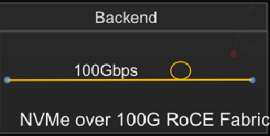
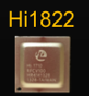

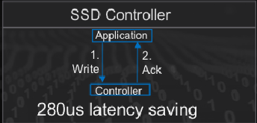

Flashlink™ Self-developed Key Hardware
OceanStor 100D can choose Kunpeng server with up to 48 * 2 cores per node.
High speed 100Gps.
Low latency
RDMA/FC/Eth/InfiniB/TCP
0.5ms consistent latency
3M hr MTBF, highest in industry
Local wear leveling
Bad block mgmt.
Data Redundancy
Background inspection
Full SAS/NVMe support
Sensor Monitoring
Error diagnostics
Scalability
Reliability
Performance
Usability
Cost
Notes:
Good storage solution is to provide high and reliable data storage service. Performance, reliability, life time and economical factor are major concern from customers.
Oceanstore Dorado V6 lays a solid foundation upon HW proprietary chips and from there build up sophisticated but flexible infrastructure to answer various customer need.

Slide 15
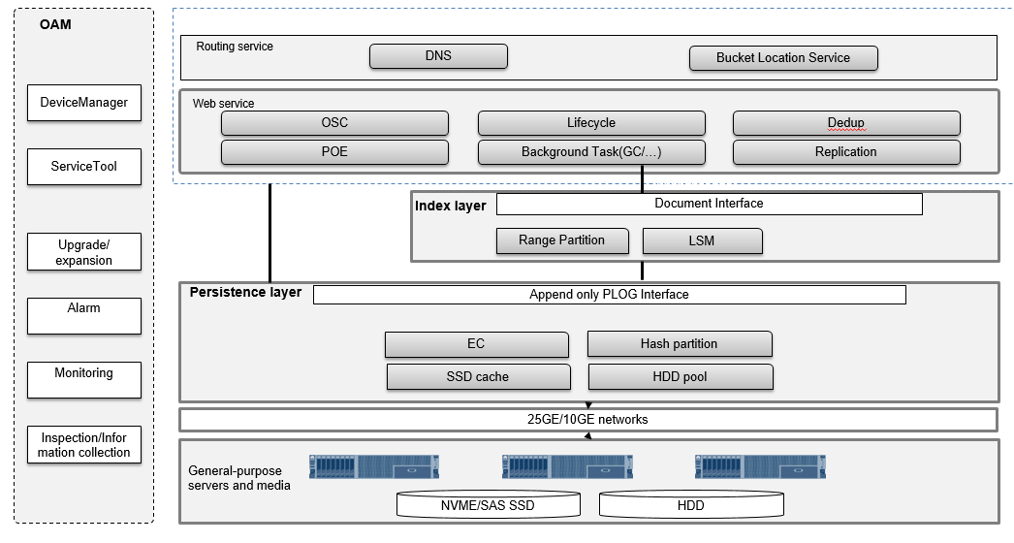
OceanStor 100D Object Software Architecture Diagram
Scalability
Reliability
Performance
Usability
Cost

Slide 16
OceanStor 100D Software Object IO Workflow Diagram
S3 Requests
DNS Routing
DHT Routing
MetaData
Data
Segment
Segment
Segment
Persistence Layer
Persistence Layer
Caching
Caching
Read
Memory
Read
Memory
Read
Write
SSD
Read
Write
SSD
Read
Write
HDD
Read
Write
HDD
Scalability
Reliability
Performance
Usability
Cost

Slide 17
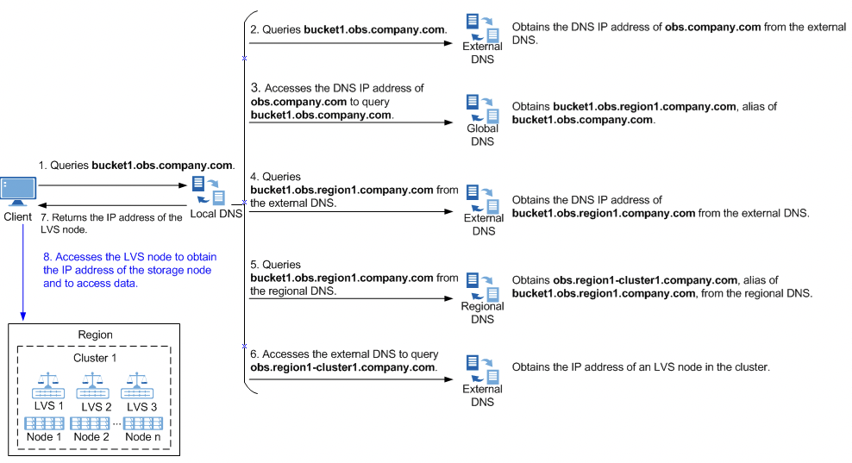
OceanStor 100D DNS Routing
Scalability
Reliability
Performance
Usability
Cost

Slide 18

OceanStor 100D Object Access Routing
Metadata Routing
Data Routing
A, AA, AB, ABA, ABB, ............, ZZZ
Data
…
...
Node 1
Node 2
Node 3
Node n
Segment 0
Segment 1
Segment 2
Segment n
Range Partition
1. Small Objects Aggregation
1. Metadata is evenly distributed in lexicographic order + range partitioning mode. Metadata is cached to SSDs.
You can locate the node where the metadata index resides based on the bucket name and prefix to quickly search for and traverse metadata.
Data is DHTed to different nodes with EC
Scalability
Reliability
Performance
Usability
Cost
Notes:
From white paper

Slide 19
Persistence Layer - Append Only Architecture
Random Write (8 KB) |  |  | Sequential Write (8 KB Aggregation -> Large Size)
Disk Type | Performance | GC Impact | Disk Type | Performance | GC Impact
HDD | 150 IOPS / 1.2 MB/s | / | HDD | 5120 IOPS / 40 MB/s | /
SSD | 40K IOPS / 312 MB/s | Significant | SSD | 153K IOPS / 1200 MB/s | Less
SCM | 200K IOPS / 1562 MB/s | / | SCM | 640K IOPS / 5000 MB/s | /
Optimal Disk Performance
Reducing WA
Natural Snapshot Support
......
......
......
A
B
A'
B'
Logical address overwrite
Cache Linear space
A
B
C
D
A'
E
F
B'
......
Data Write
Physic address space
Segment
Segment
Segment
......
Scalability
Reliability
Performance
Usability
Cost

